Slide 1
Citi Bike Location Data October 2016

Slide 2
In [1]:
import pandas as pd import numpy as np import os
import glob
import xlrd pd.options.display.max_columns = 40 import warnings warnings.filterwarnings('ignore') import matplotlib.pyplot as plt
import seaborn as sns; sns.set(style="white", color_codes=True)

Slide 3
Initial Import and Cleanup of Data from Citi Bike
</font>

Slide 4
In [2]:
df1 = pd.read_csv("https://s3.amazonaws.com/tripdata/201610-citibike-tripdata.zip"
)
df1.head()
Out[2]:
 | Trip Duration | Start Time | Stop Time | Start Station ID | Start Station Name | Start Station Latitude | Sta Stati Longitu
0 | 328 | 2016- 10-01 00:00:07 | 2016- 10-01 00:05:35 | 471 | Grand St & Havemeyer St | 40.712868 | -73.9569
1 | 398 | 2016- 10-01 00:00:11 | 2016- 10-01 00:06:49 | 3147 | E 85 St & 3 Ave | 40.778012 | -73.9540
2 | 430 | 2016- 10-01 00:00:14 | 2016- 10-01 00:07:25 | 345 | W 13 St & 6 Ave | 40.736494 | -73.9970
3 | 351 | 2016- 10-01 00:00:21 | 2016- 10-01 00:06:12 | 3307 | West End Ave & W 94 St | 40.794165 | -73.9741
4 | 2693 | 2016- 10-01 00:00:21 | 2016- 10-01 00:45:15 | 3428 | 8 Ave & W 16 St | 40.740983 | -74.0017
o d
8
7
4
2
0

Slide 5
In [3]:
df1.shape
Out[3]:
(1573872, 15)

Slide 6
In [4]:
df1.sort_values('Start Time').head()
Out[4]:
 | Trip Duration | Start Time | Stop Time | Start Station ID | Start Station Name | Start Station Latitude | Sta Stati Longitu
0 | 328 | 2016- 10-01 00:00:07 | 2016- 10-01 00:05:35 | 471 | Grand St & Havemeyer St | 40.712868 | -73.9569
1 | 398 | 2016- 10-01 00:00:11 | 2016- 10-01 00:06:49 | 3147 | E 85 St & 3 Ave | 40.778012 | -73.9540
2 | 430 | 2016- 10-01 00:00:14 | 2016- 10-01 00:07:25 | 345 | W 13 St & 6 Ave | 40.736494 | -73.9970
3 | 351 | 2016- 10-01 00:00:21 | 2016- 10-01 00:06:12 | 3307 | West End Ave & W 94 St | 40.794165 | -73.9741
4 | 2693 | 2016- 10-01 00:00:21 | 2016- 10-01 00:45:15 | 3428 | 8 Ave & W 16 St | 40.740983 | -74.0017
o d
8
7
4
2
0

Slide 7
In [5]:
df1['Trip Duration'] = df1['Trip Duration'].astype('float') df1.dtypes
Out[5]:
Trip Duration Start Time Stop Time
float64 object object int64 object float64 float64 int64 object float64 float64 int64 object float64 int64
Start Start Start Start
Station Station Station Station
ID
Name Latitude Longitude
End Station End Station End Station End Station
ID
Name Latitude Longitude
Bike ID User Type Birth Year Gender
dtype: object

Slide 8
Data Grouping and Preliminary Analysis

Slide 9
Group and describe the top 20 Starting Stations by Trip Count

Slide 10
In [6]:
df2 = df1.groupby('Start Station Name')['Trip Duration'].describe().sort_values('c ount', ascending=False).head(20)

Slide 11
Chart showing the mean trip duration for the to 20 locations by total trips

Slide 12
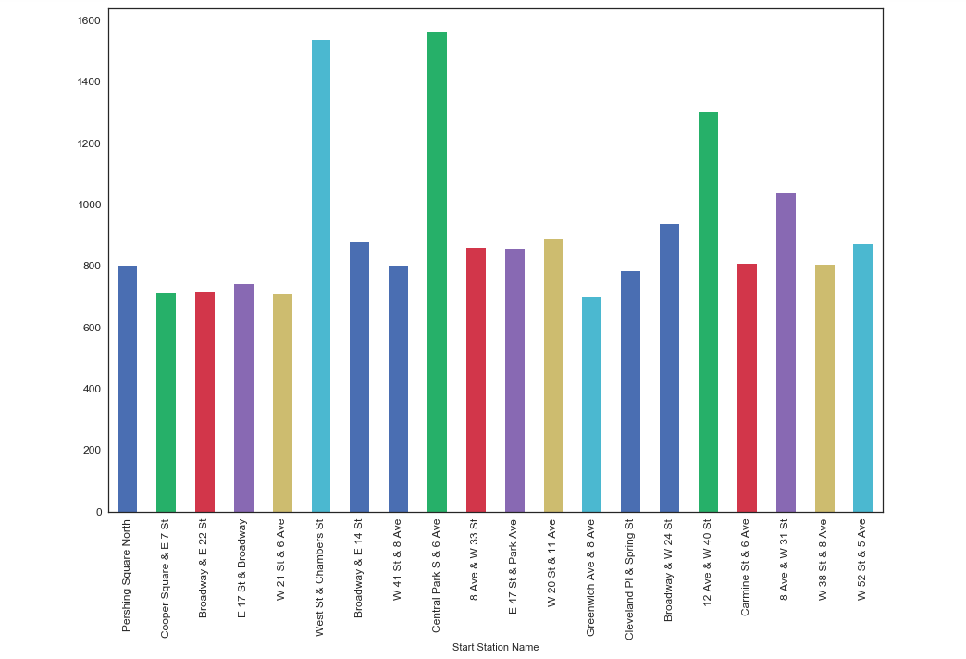
In [7]:
df2['mean'].plot(kind="bar", figsize=(15, 10), fontsize=12)
Out[7]:
<matplotlib.axes._subplots.AxesSubplot at 0x107080b00>

Slide 13
In [8]:
df1['Start Time'] = pd.to_datetime(df1['Start Time'])

Slide 14
In [9]:
df1.index = df1['Start Time']
del df1['Start Time']

Slide 15
In [10]:
df3 = pd.DataFrame(df1.resample('d').size())

Slide 16
In [11]:
df3 = df3.rename(columns={0: 'Total Trips'}) df3['Day of Week'] = df3.index.dayofweek
df3.replace({'Day of Week':{0: 'Mon', 1: 'Tues', 2: 'Wed', 3: 'Thurs', 4: 'Fri', 5
: 'Sat', 6: 'Sun'}})
Out[11]:
 | Total Trips | Day of Week
Start Time
2016-10-01 | 39811 | Sat
2016-10-02 | 41023 | Sun
2016-10-03 | 56384 | Mon
2016-10-04 | 60379 | Tues
2016-10-05 | 65053 | Wed
2016-10-06 | 67585 | Thurs
2016-10-07 | 65896 | Fri
2016-10-08 | 34625 | Sat
2016-10-09 | 21689 | Sun
2016-10-10 | 52255 | Mon
2016-10-11 | 58768 | Tues
2016-10-12 | 57690 | Wed
2016-10-13 | 61217 | Thurs
2016-10-14 | 60566 | Fri

Slide 17
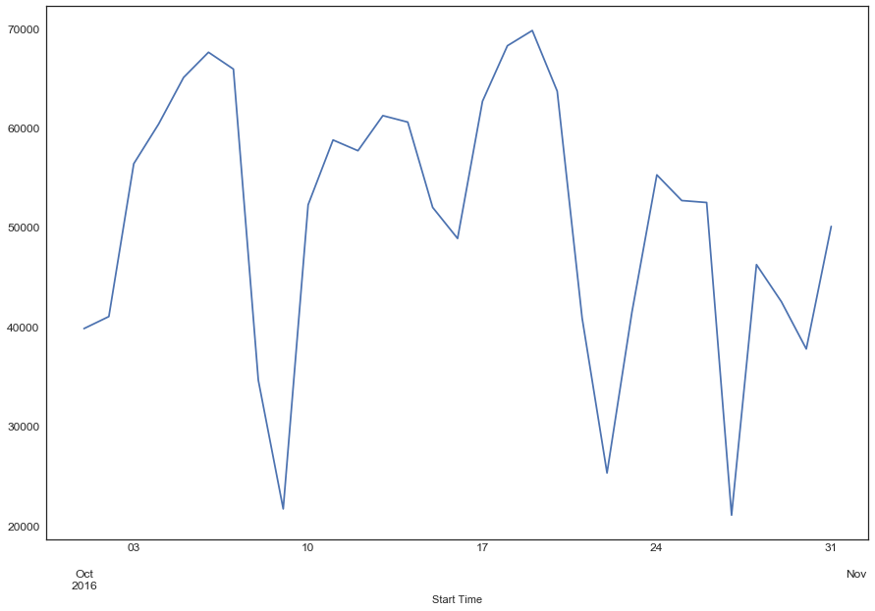
In [12]:
df3['Total Trips'].plot(figsize=(15, 10), fontsize=12)
Out[12]:
<matplotlib.axes._subplots.AxesSubplot at 0x1a0e3da588>

